Slide 1

INTERNET DO’S AND DON’TS (안전한 인터넷 사용)

Slide 2
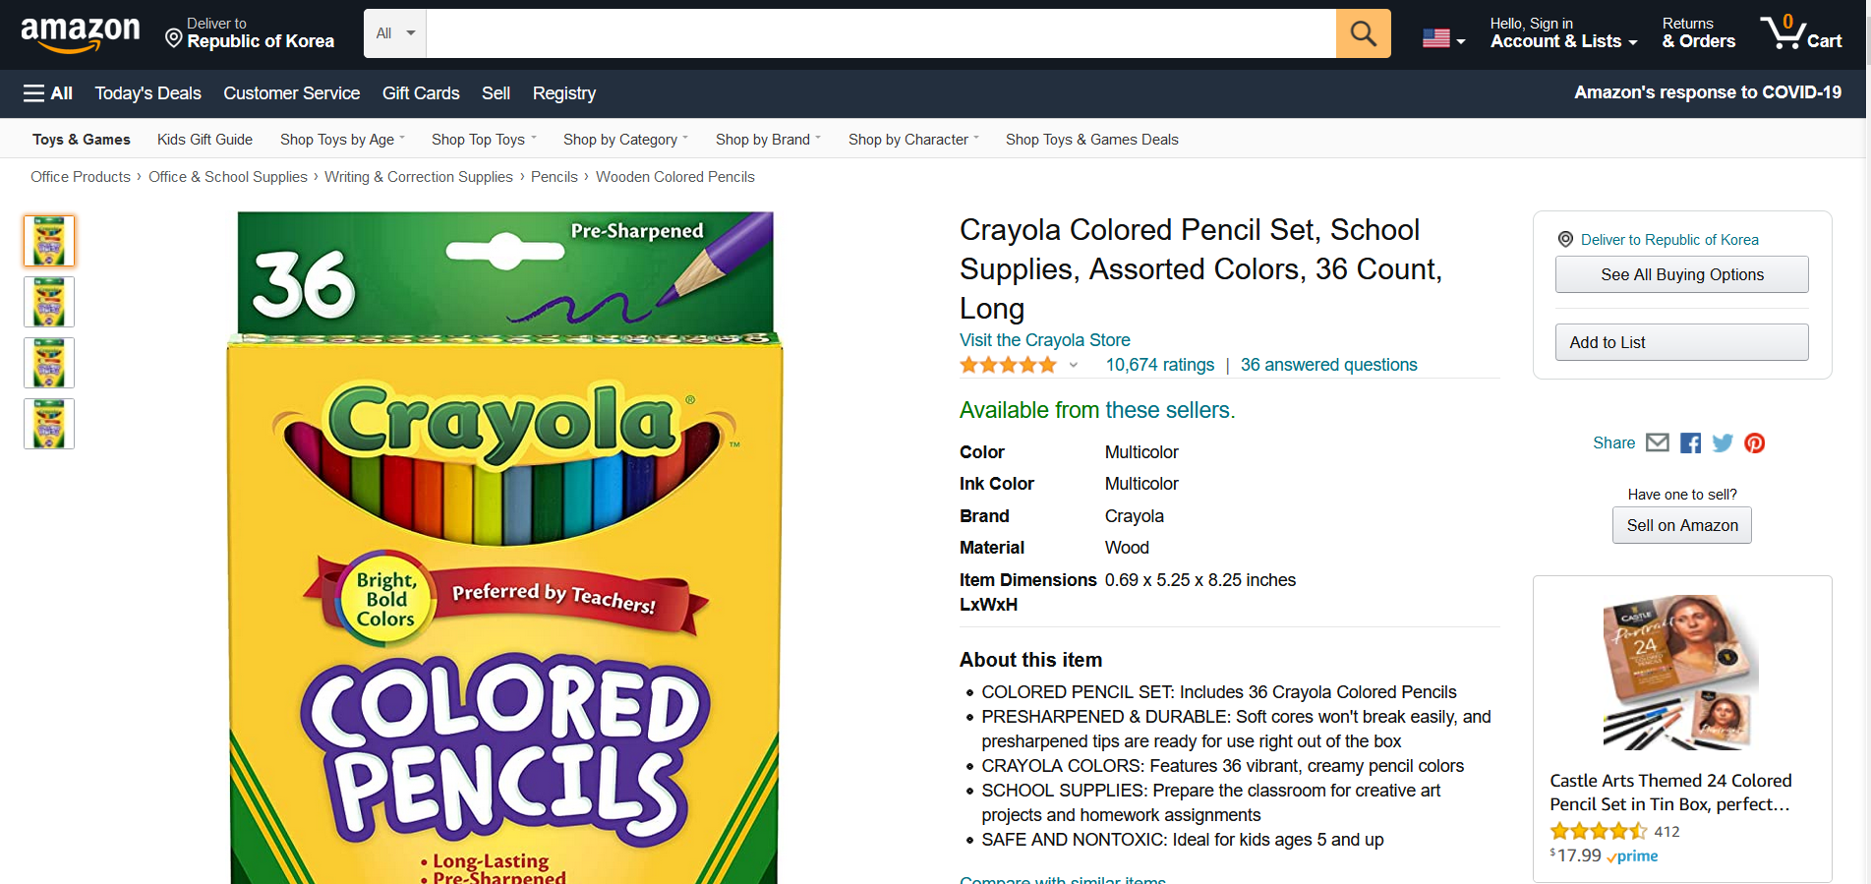

Slide 3
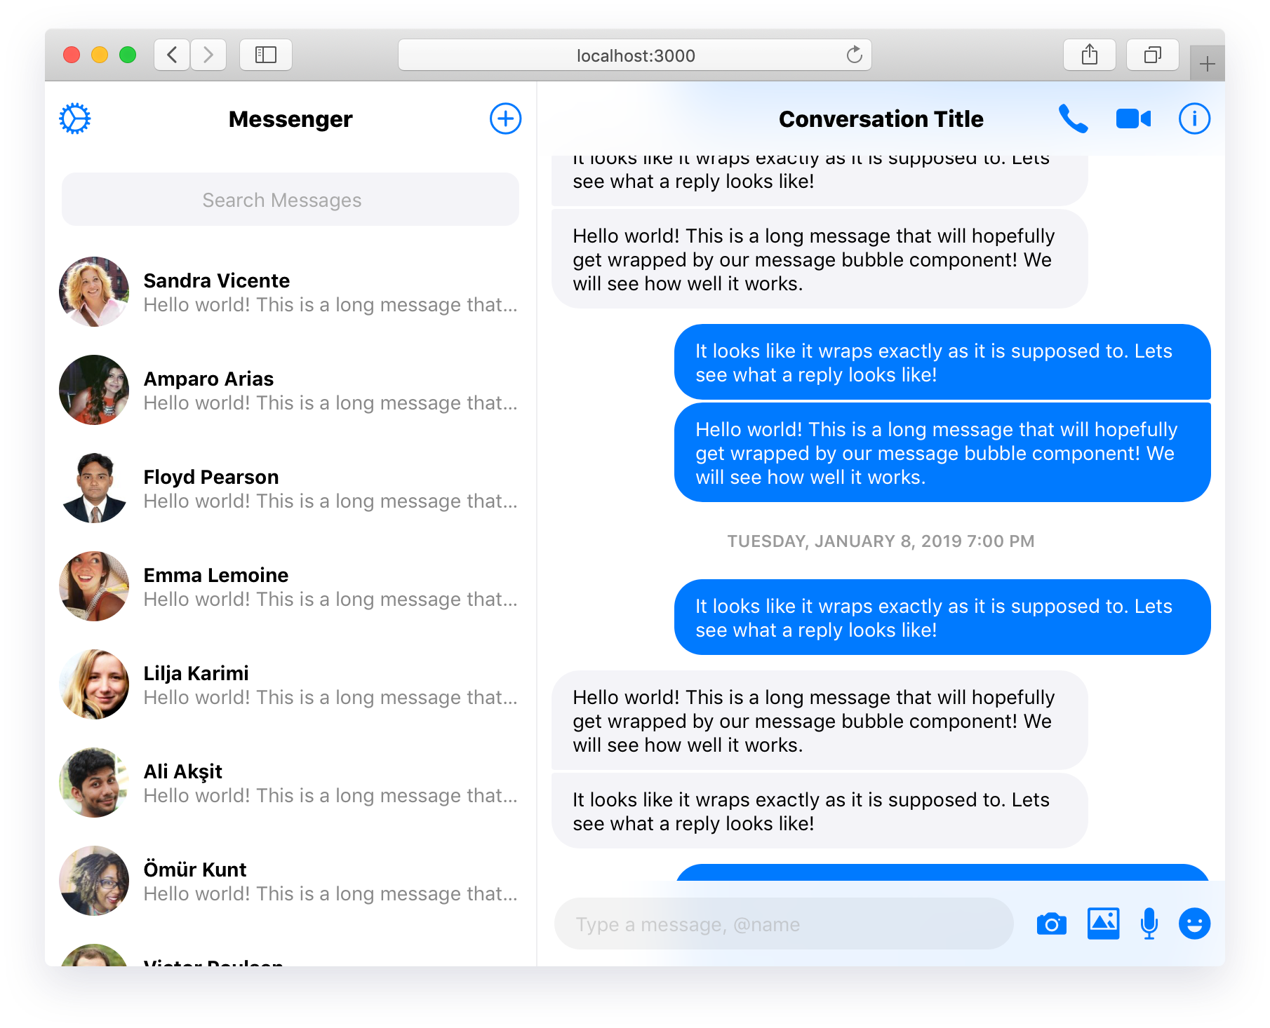

Slide 5
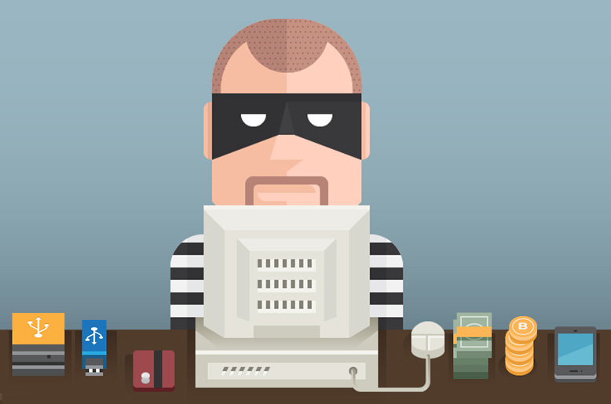
Sadly, there are some people who are not nice on the internet!

Slide 6
SMART
You have to be
When using the internet

Slide 7



S = SAFE
Don’t share personal stuff like your full name, address, password or phone number.
Someone could try to use this information to find you.

Slide 8
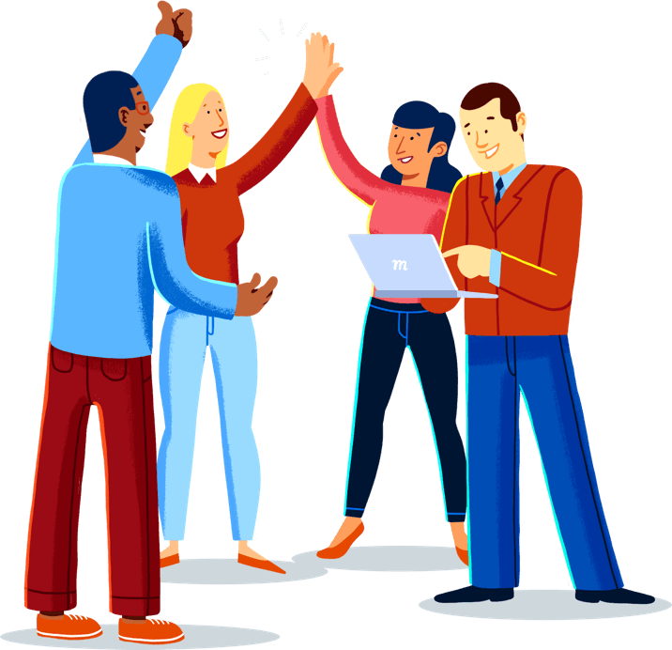
M = MEET
Only talk to people you know or met in person.
Ask your parents first before you talk to anybody online

Slide 9

A = ASK
Always ask permission from a grown up if you want to download or buy games, open emails or files
It may contain bad messages or make your computer sick!

Slide 10
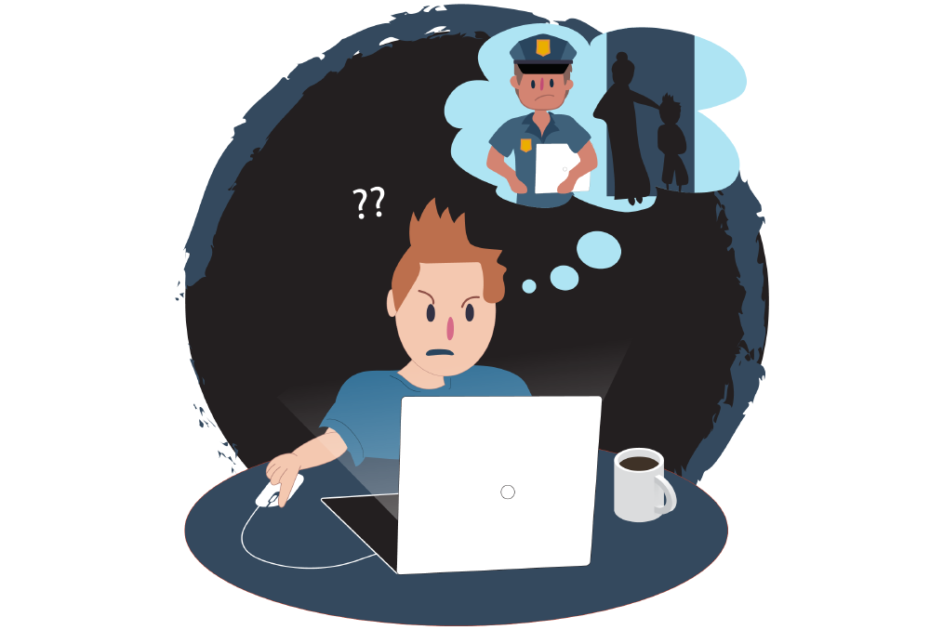
R = RESPONSIBILITY
Think before you send something.
You can get in trouble for sharing an inappropriate picture or saying a nasty comment about someone!

Slide 11
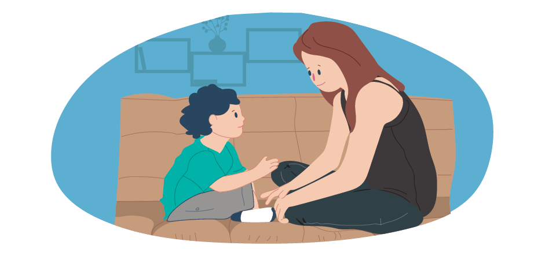
T = TALK
Talk to a grown up that you trust if someone or something makes you feel scared or uncomfortable

Slide 12
THANK YOU FOR WATCHING!
봐줘서 고마워!

